Slide 1
Introduction to PowerApps

Slide 2
Canvas Apps

Slide 3
Canvas Apps help business-power-users to create and use custom business apps across platforms using Excel and PowerPoint skills
Connect to data & systems you’re already using easily
Create apps, forms, and workflows without writing code
Use apps on any device – both web and mobile

Slide 4
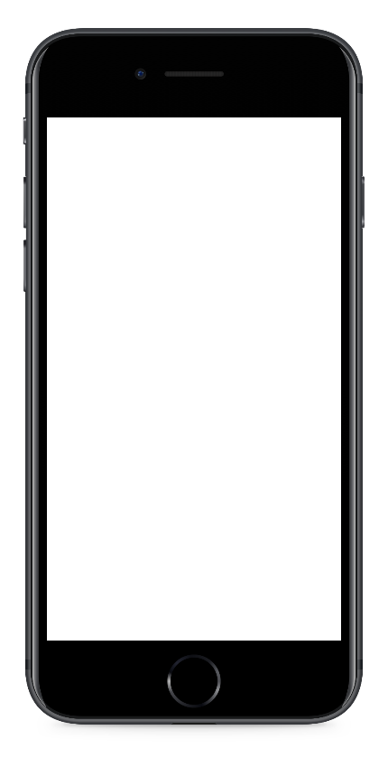
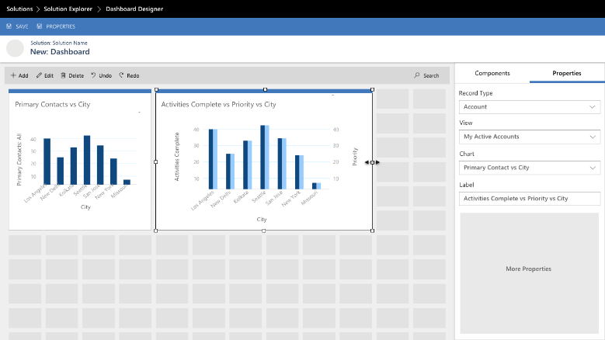
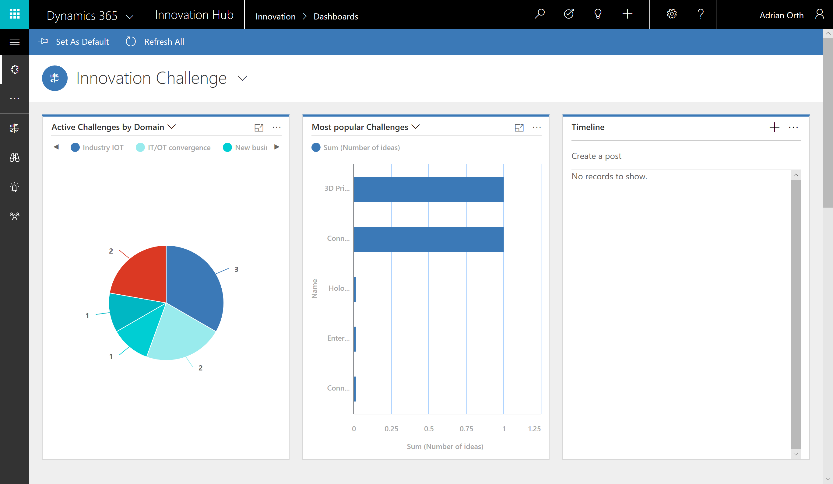
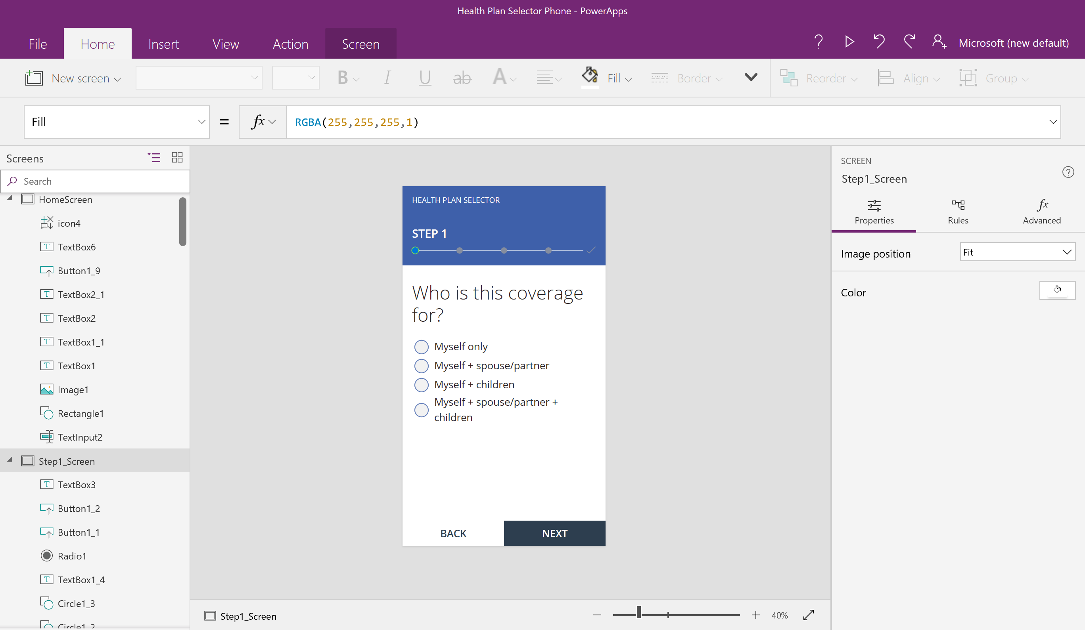
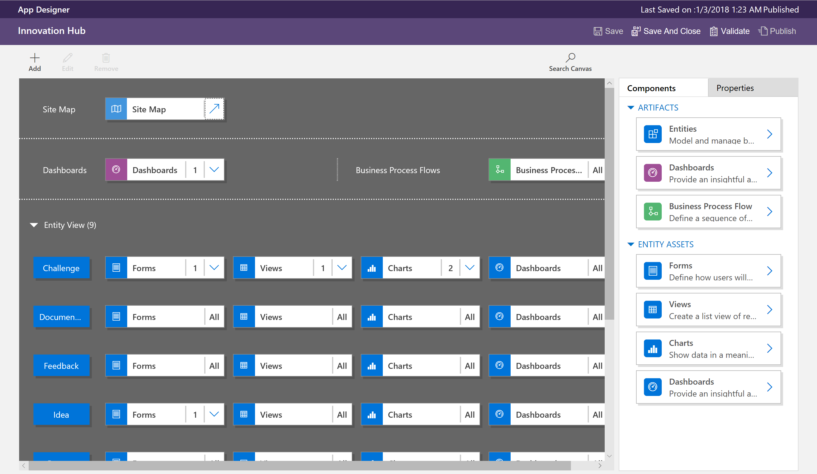
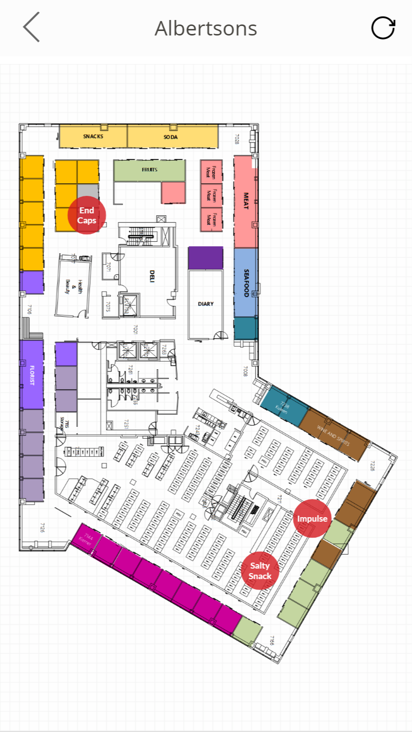
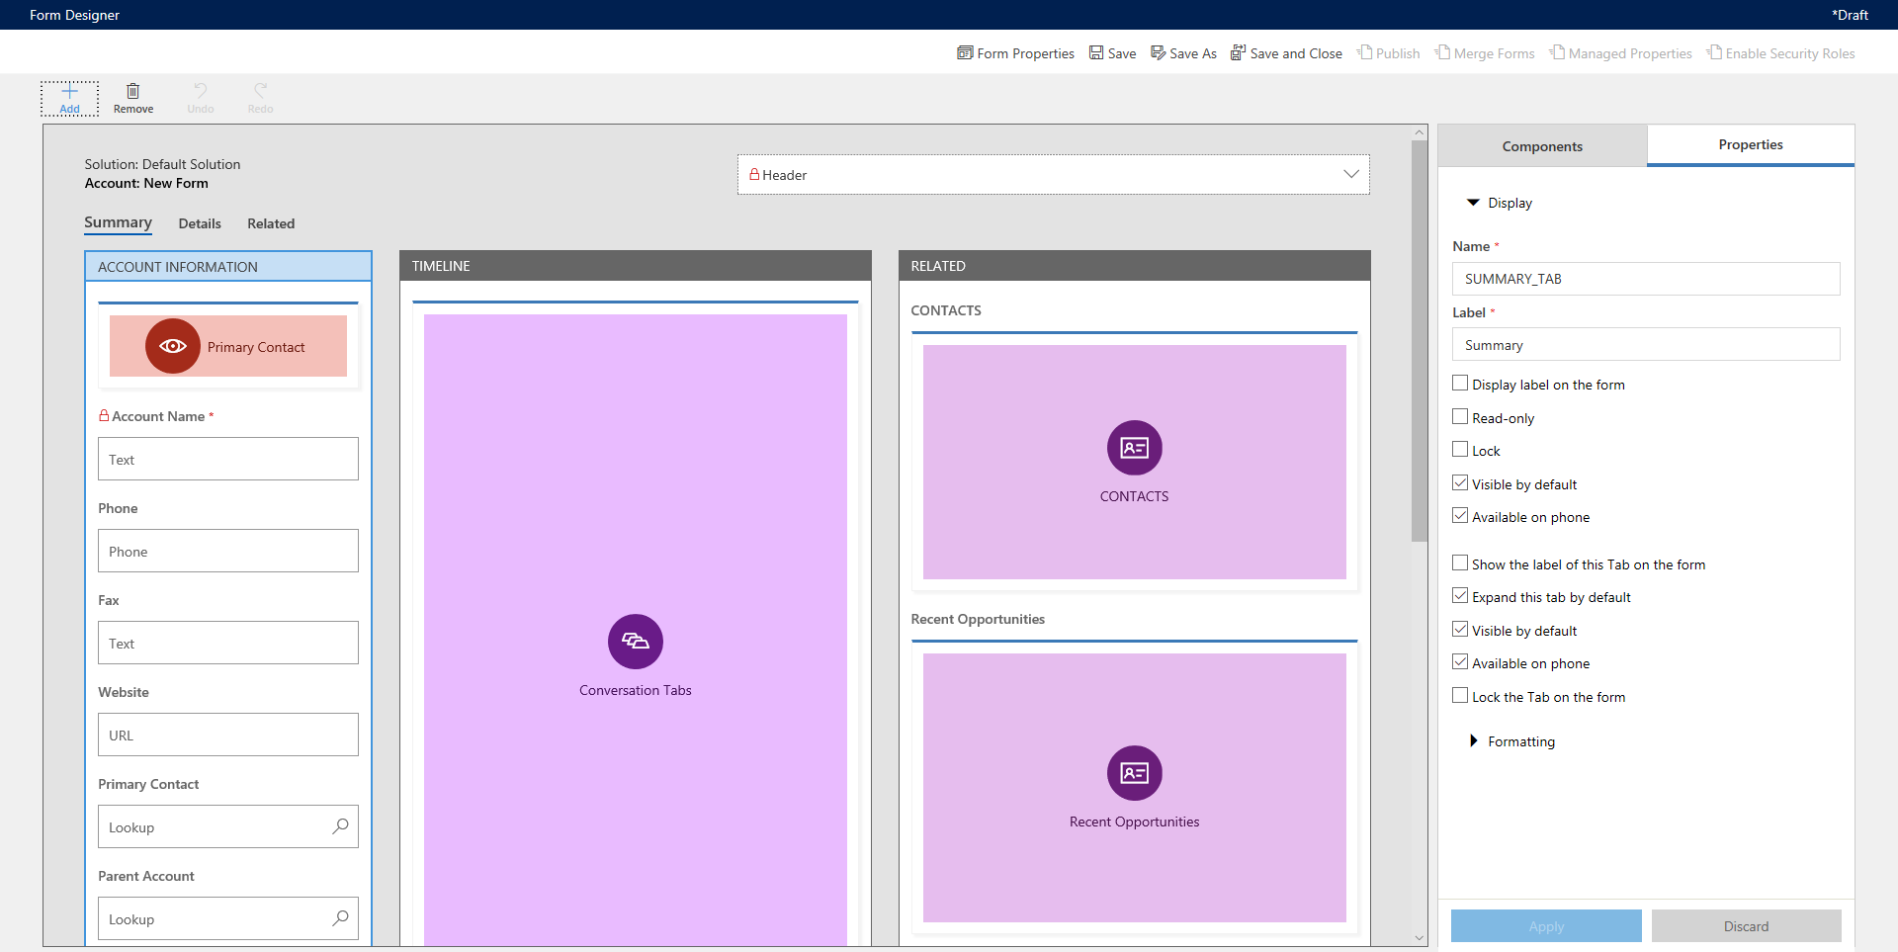
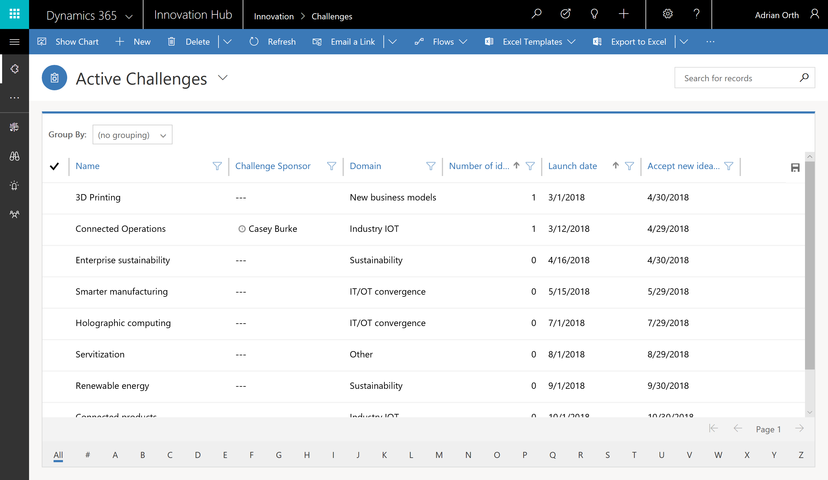
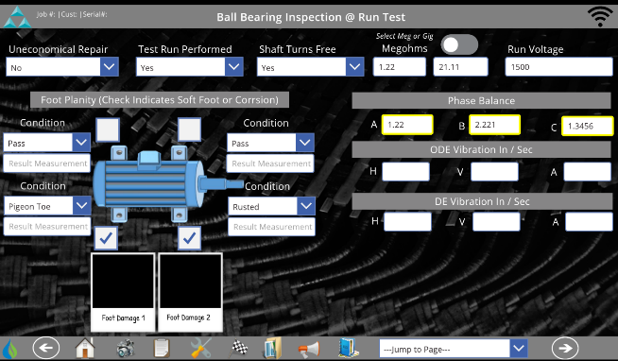
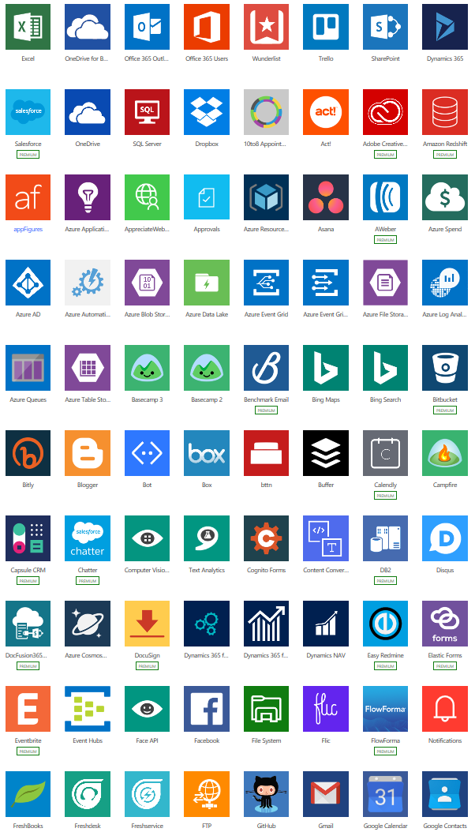
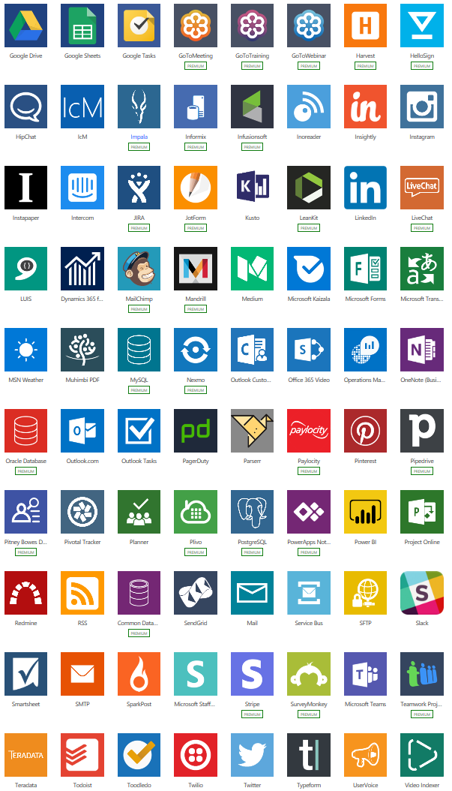
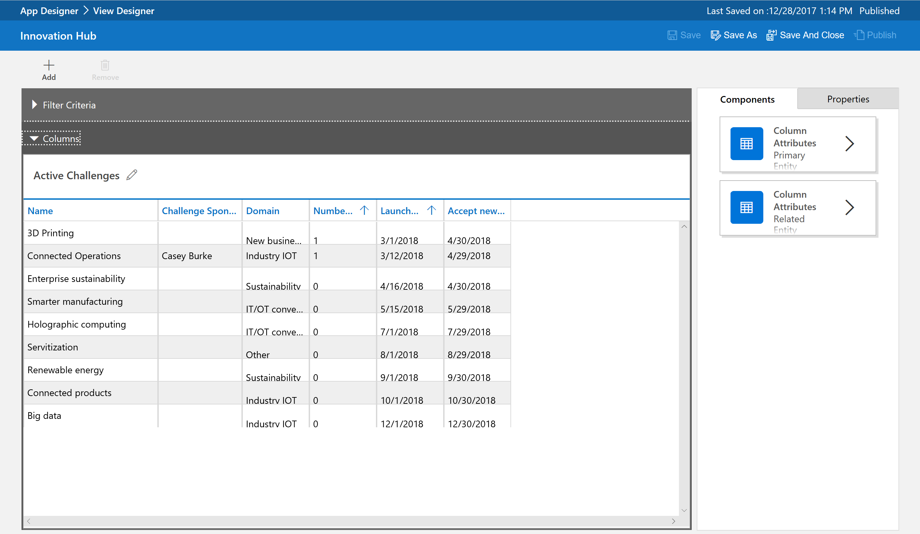
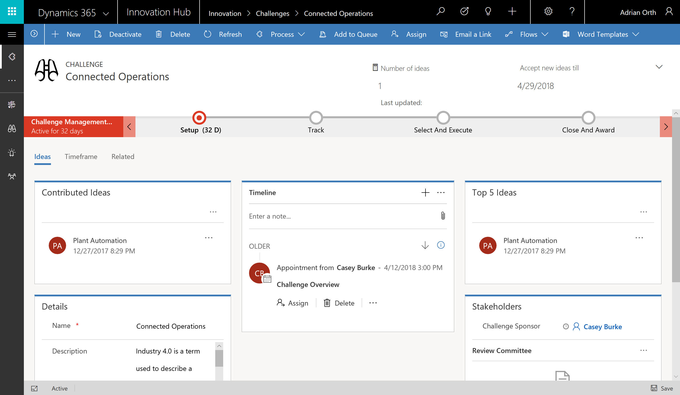
Focus on Canvas Apps
Canvas apps
Start with user experience
WYSIWYG designer
Task- and role-based apps
Mash up data from 200+ sources
Model-driven apps
Built on the Common Data Service for Apps
Start with a data model, relationships, and business processes
Build End-to-End business applications

Slide 5
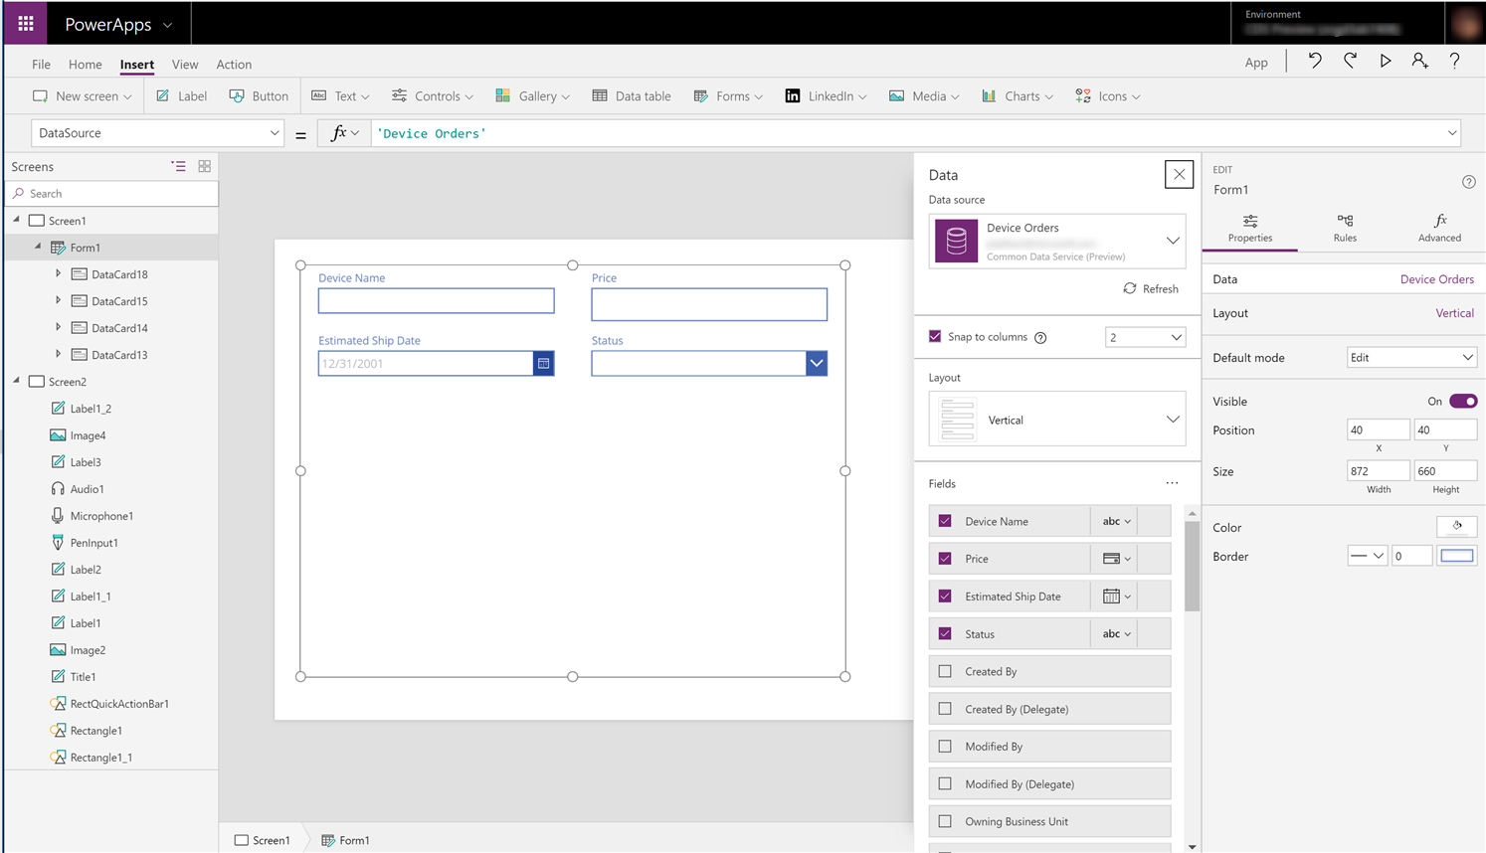
Easy Authoring
Truly WYSIWYG – full control over user experience, use it as you build it
Create app logic with familiar Excel-like expressions
Mash up data from multiple sources right at the app level

Slide 6
Cloud and on-premises connectivity
Built-in connectivity to 200+ cloud services, files, databases, web APIs, etc.
Seamless hybrid connectivity to on-premises systems via the On-Premises Data Gateway
Build custom connectors for everyone to leverage
Enterprise-grade
Cloud and on-premises connectivity
Pro-developer extensibility

Slide 7
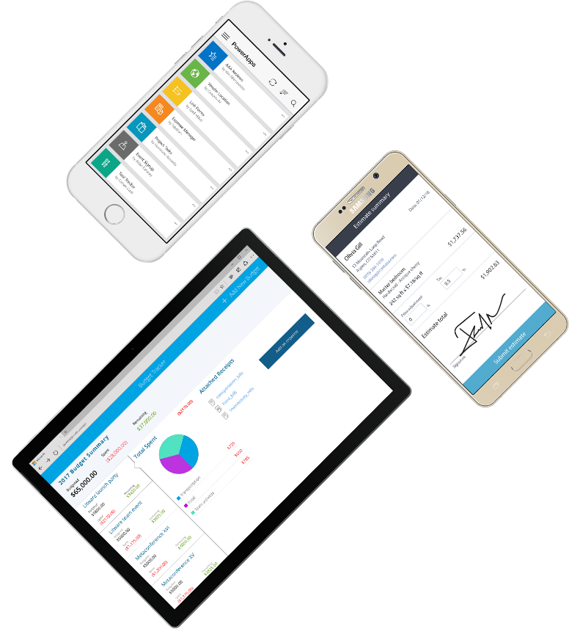
Cross-platform
Publish instantly to iOS, Android, Windows, and the web
Sharing apps is like sharing documents
Manage across environments

Slide 8
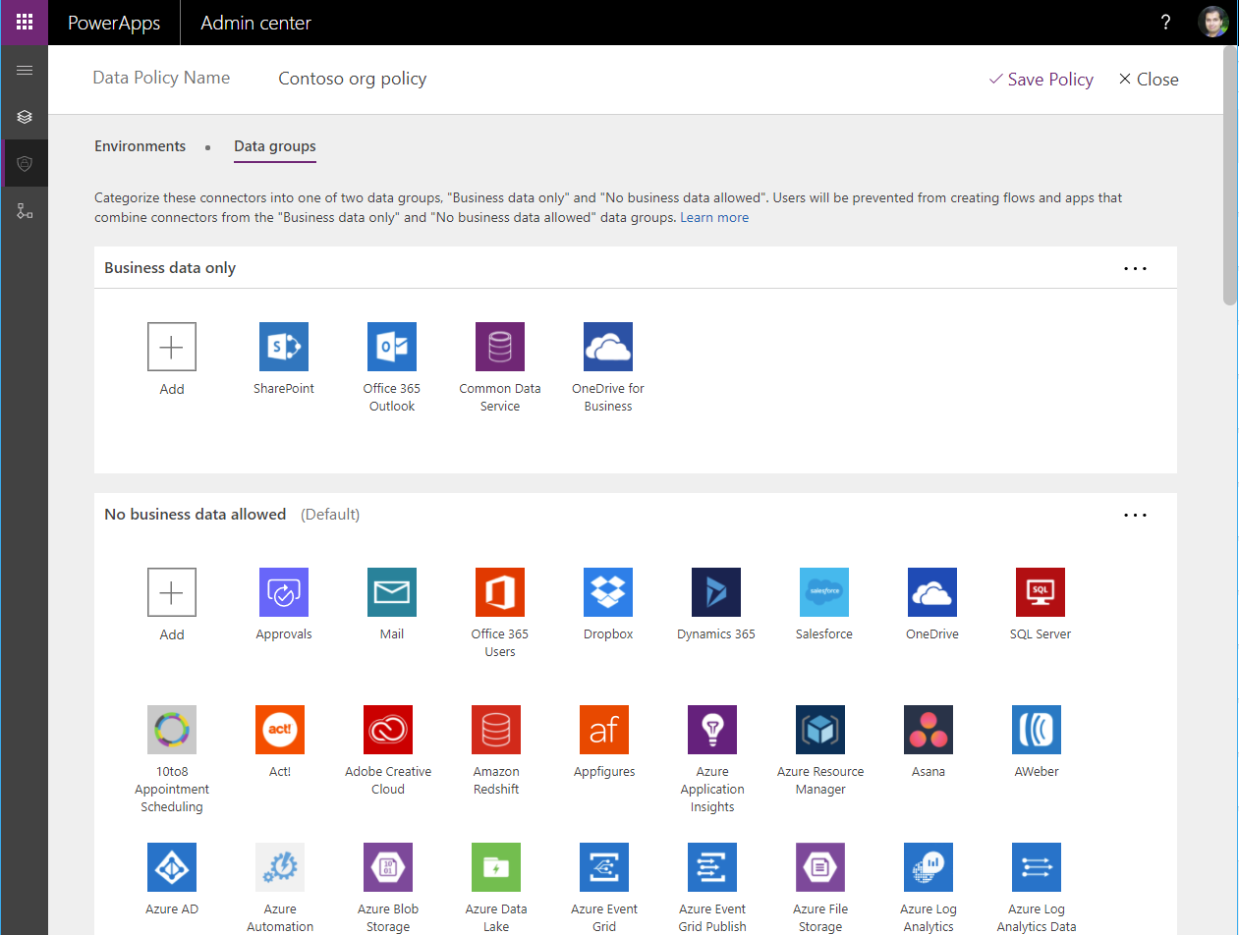
Enterprise-grade management and control
All identity is managed through Azure Active Directory, enabling rich policies and multi-factor authentication
Admin Center providing full audit logs, usage analytics, data loss prevention, security and data management
Centrally manage all your apps, first and third party, deployed across your organization
Enterprise-grade
Cloud and on-premises connectivity
Pro-developer extensibility

Slide 9
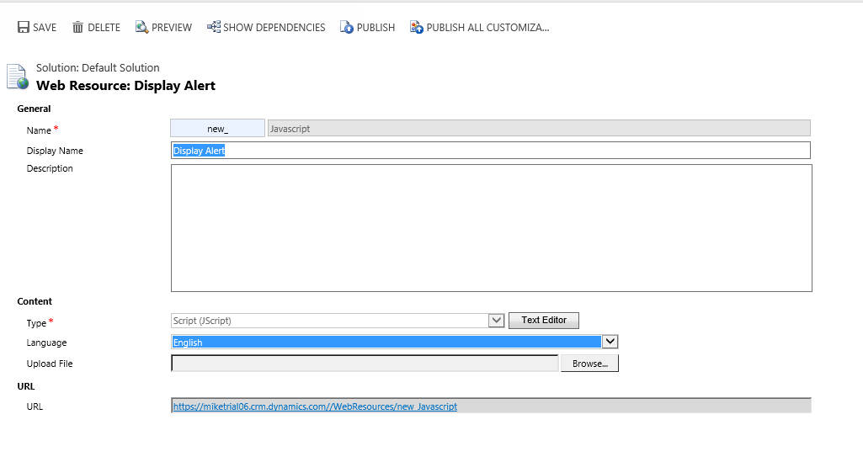
Amplify professional developer productivity
Extend applications using custom code
Build custom connectors that everyone can use
Write advanced client or server-side logic leveraging Azure Machine Learning, Cognitive Services, Bing APIs, custom code, or any service of your choice
Enterprise-grade
Cloud and on-premises connectivity
Pro-developer extensibility

Slide 10
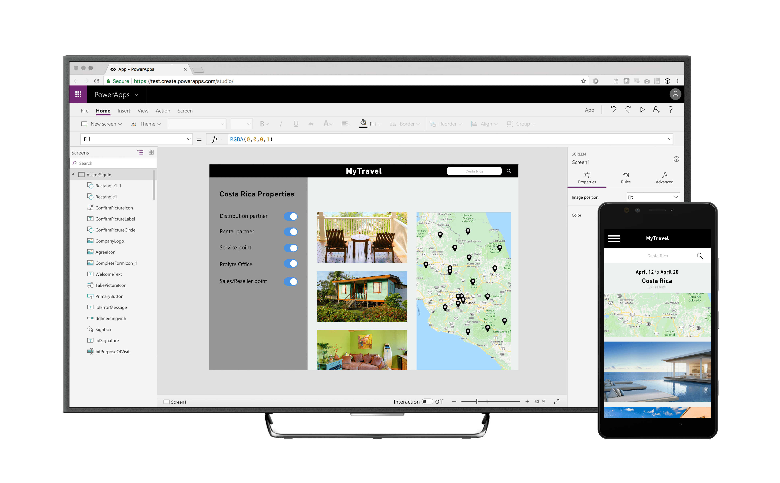
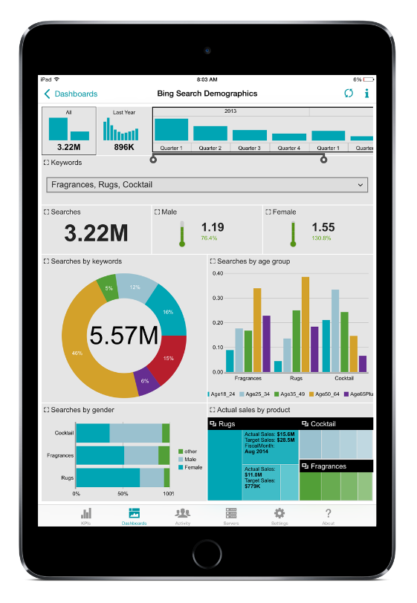
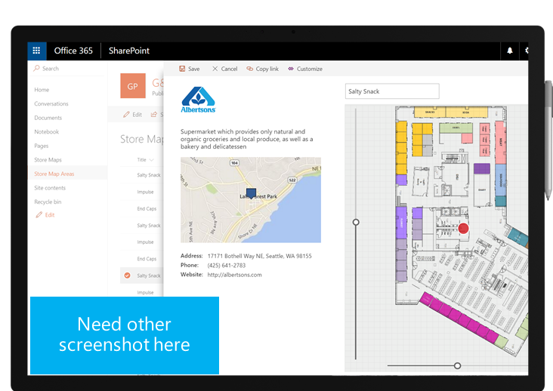
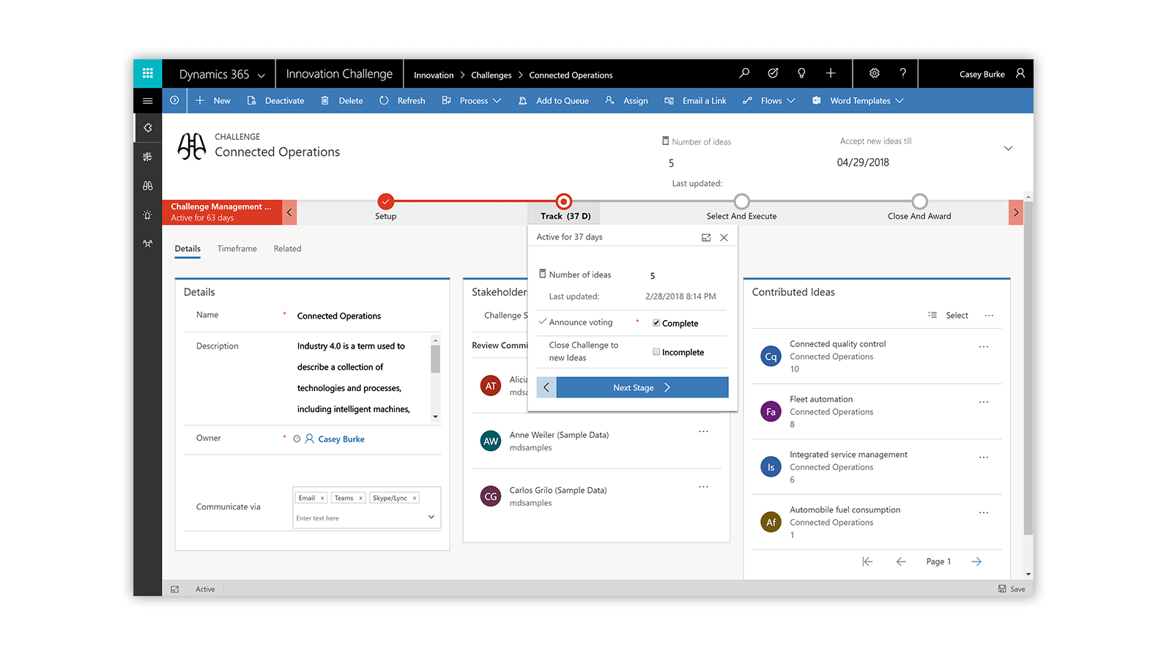
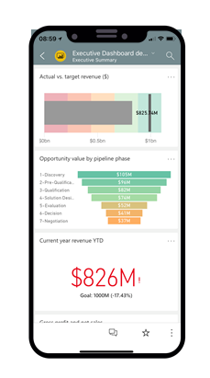
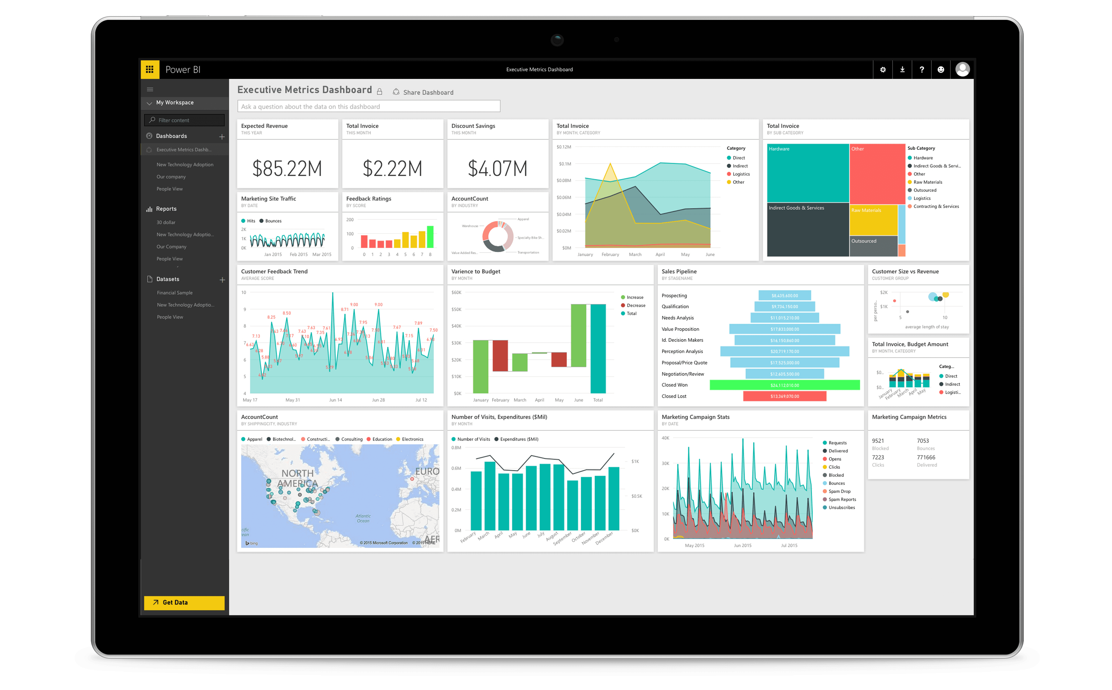
Customize, extend, and build all the apps you need
Seamless Dynamics 365, Office 365, and Azure integration along with connectors to more than 200 data sources
Tailor out-of-the-box solutions, embedded forms and dashboards
Highly customized task- and role-based apps
Immersive, end-to-end solutions
SOPHISTICATION

Slide 11
Key concepts
Notes:
This section shows key concepts in PowerApps Canvas Apps. You may choose to explain these concepts by directly showing them in action in a browser.

Slide 12
PowerApps Maker Portal [https://web.powerapps.com/]
Home page for Makers
Learn
Guided learning, documentation, community, what’s new
Manage Apps
View apps, open apps, create new apps, run sample apps, create apps from sample apps
Data
Manage Entities, option sets, data integration, connections, custom connections & gateways
Business Logic: Add Flows to your apps
Switch mode between Canvas and Model-driven

Slide 13
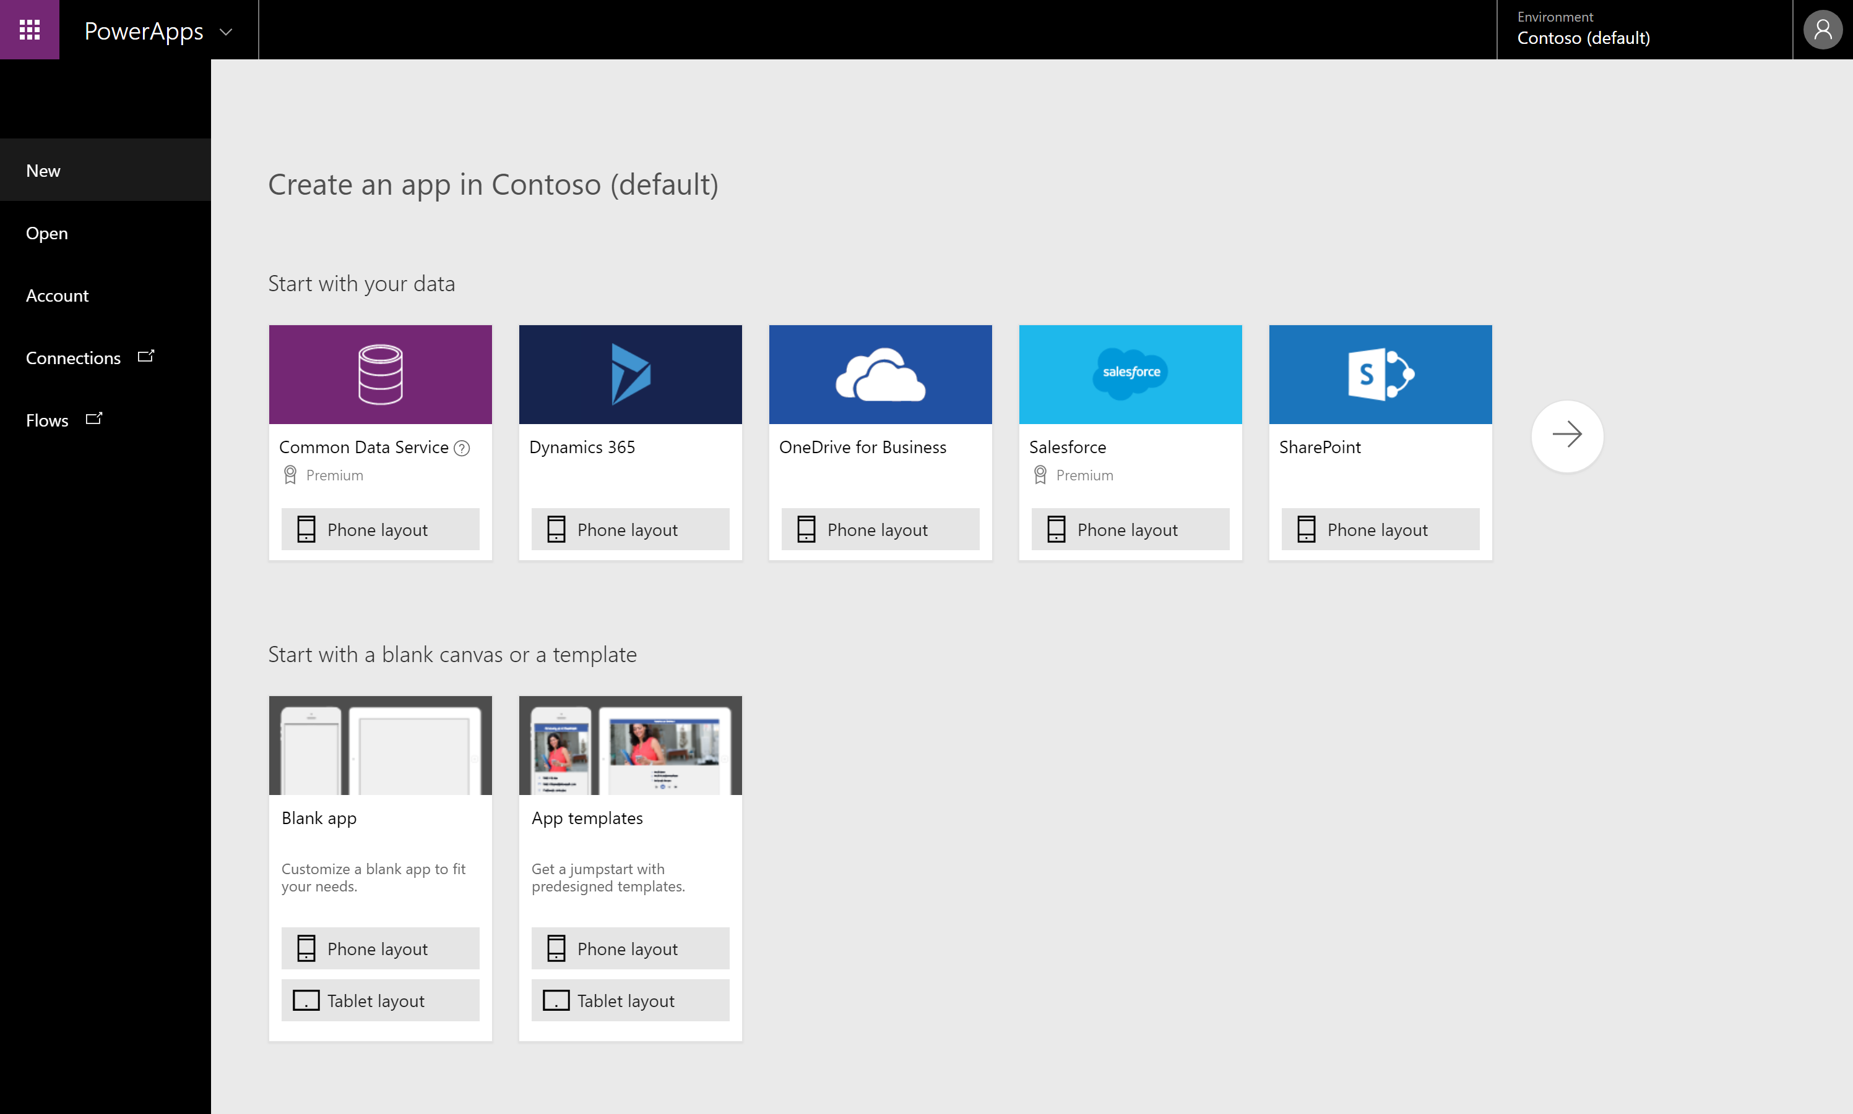
PowerApps Studio for the Web [https://create.powerapps.com/]
Canvas apps authoring experience
Start with your data
Start with a blank canvas
Start with a template

Slide 14
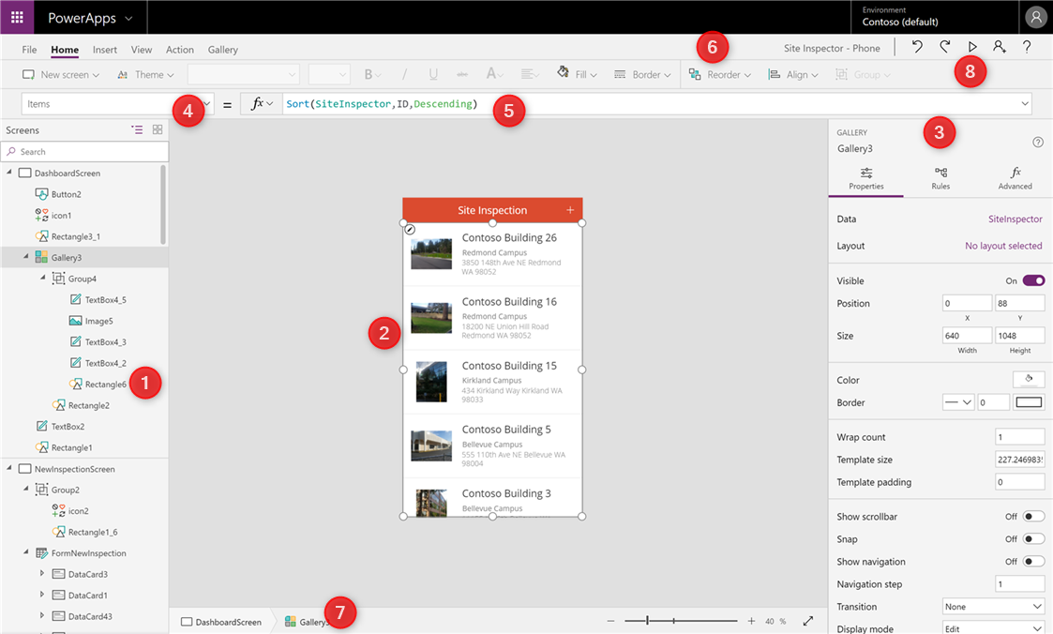
PowerApps Studio parts
Left Navigation bar
Middle pane (current screen)
Right-hand pane
Property drop-down list
Formula bar
Ribbon
Bread-crumb navigation
Preview button (F5)

Slide 15
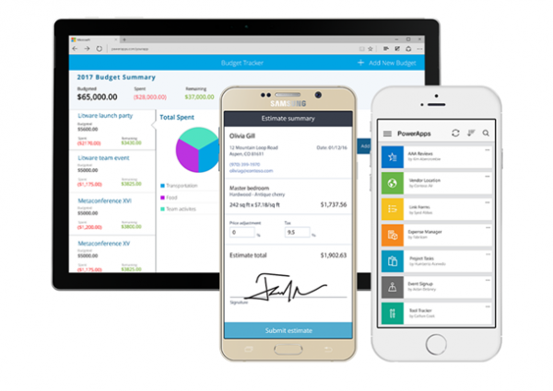
PowerApps Mobile (Player)
PowerApps Mobile for Windows, iOS, and Android
Available from respective app-stores as a free app
Sign-in using your work account (Office 365 / Dynamics 365 / Azure AD credentials)
Access all your apps or apps shared with you across environments
Google Play: https://aka.ms/powerappsandroid
Apple App Store: https://aka.ms/powerappsios
Microsoft Store: https://aka.ms/powerappswin

Slide 16
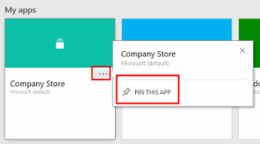
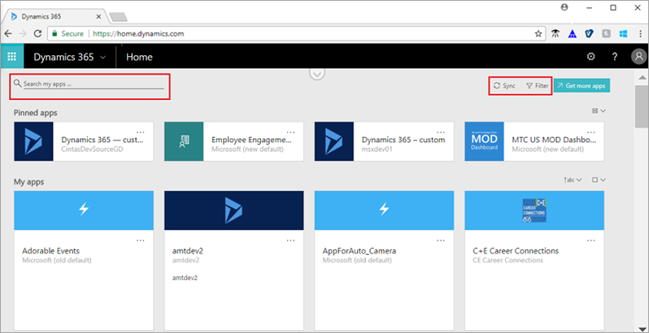
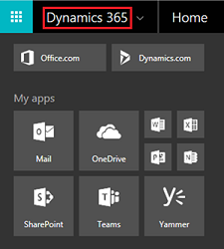
Dynamics 365 Home page [https://home.dynamics.com]
Find your apps or apps shared with you
Run all PowerApps apps (canvas or model-driven)
Run all Dynamics 365 apps (Sales, service etc…)
You don’t need a Dynamics subscription to access

Slide 17
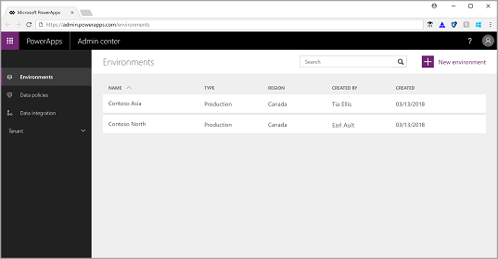
PowerApps Admin Center [https://admin.powerapps.com]
Administration of PowerApps, Microsoft Flow and Common Data Service for Apps
Create Environments & databases
Assign Data Loss Prevention policies
View active users in tenant
View apps and flows in environment or tenant

Slide 18
PowerApps Studio
Common Properties
UI: Controls
View: Data
UI-Data Binding: Properties & Formula bar

Slide 19
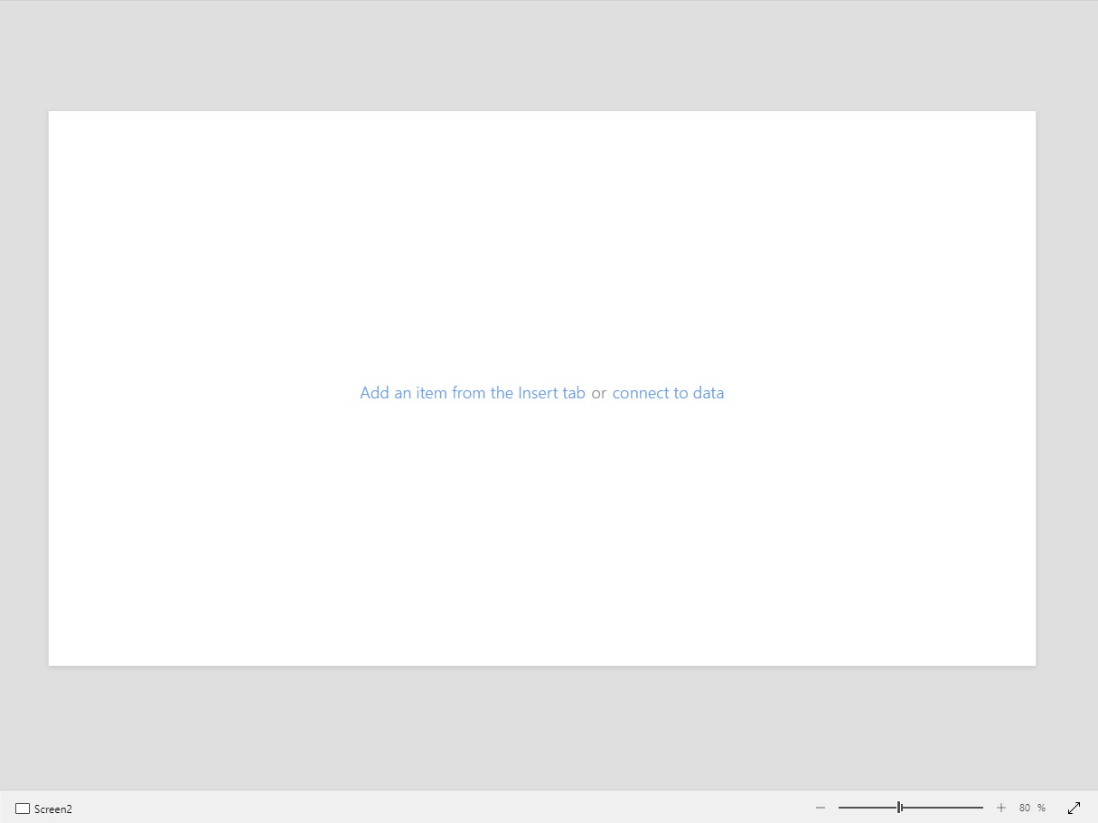
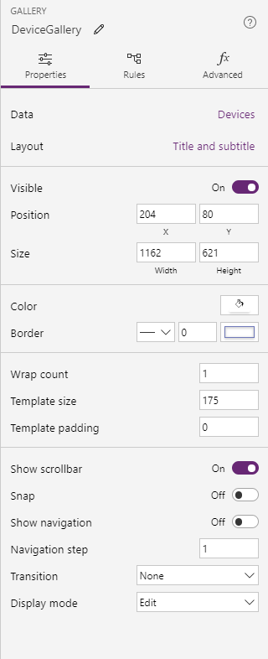
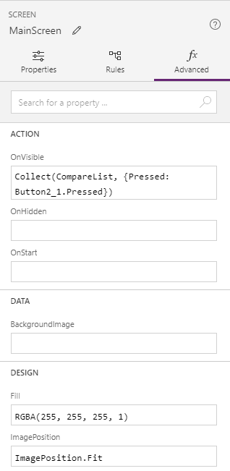
Screens & Controls View
Canvas
Properties Panel

Slide 20
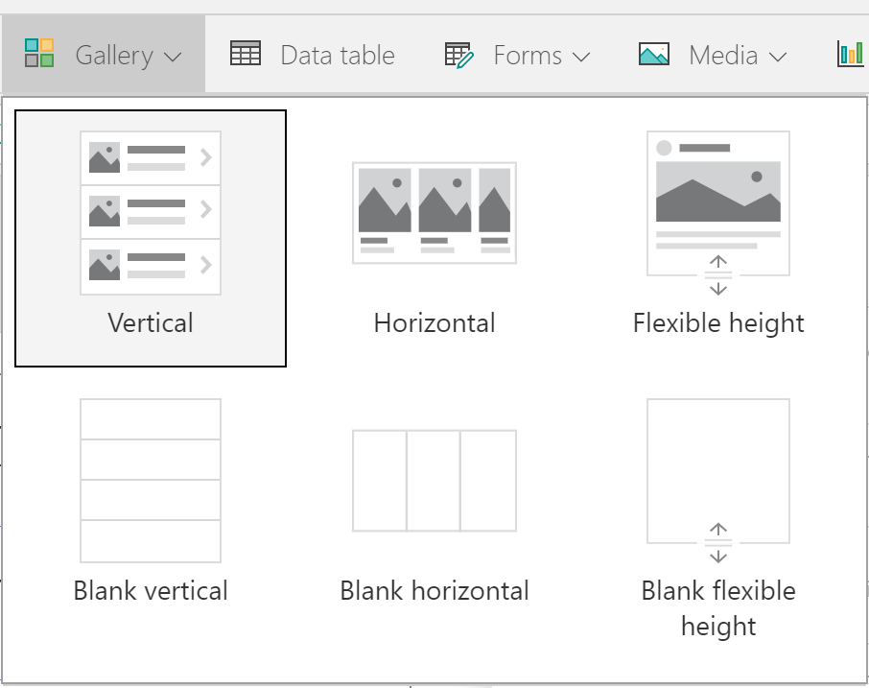
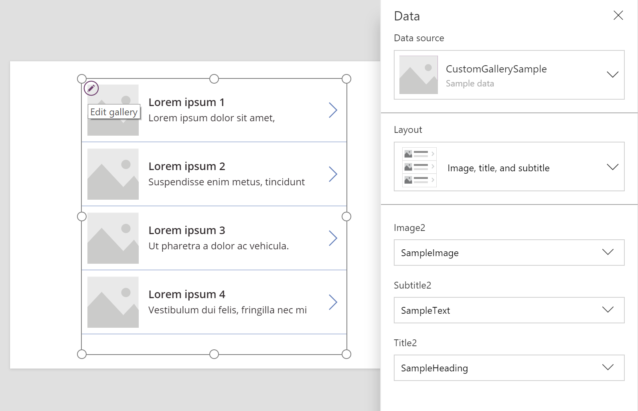
Gallery
First item is used to the edit the gallery template

Slide 21
Model-driven apps

Slide 22
Canvas apps start with user experience, with pixel-perfect control to build highly customized task- and role-based apps that mash up data from 190+ sources
Model-driven apps leverage your data model, relationships, and business processes to automatically generate immersive, responsive applications

Slide 23
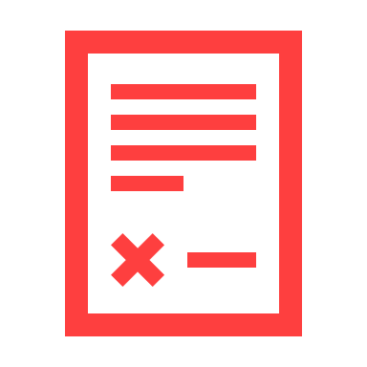
PowerApps Model-driven apps provides a metadata-driven architecture for creating and customizing apps without writing code
Rich component-focused no-code design environments
Easily add Business rules and Business process flows to model your business processes
Complex responsive apps on web and mobile

Slide 24
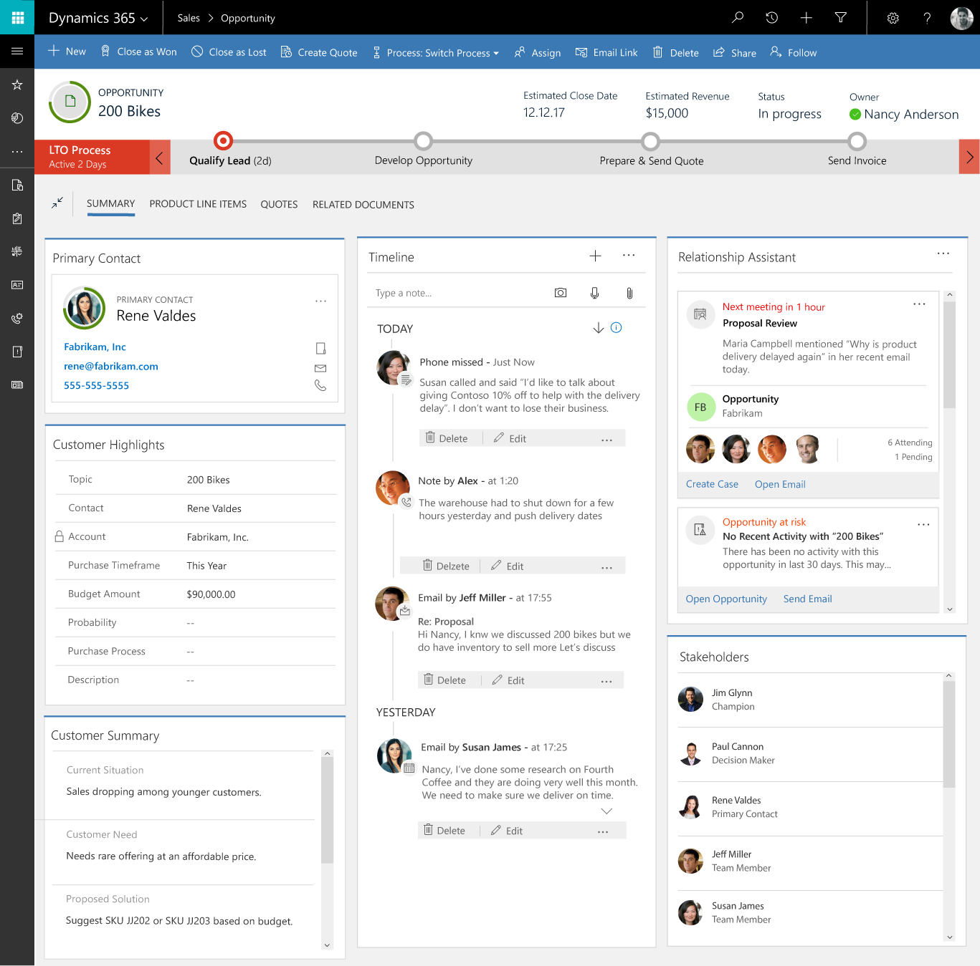
Component-focused approach to app development
Create apps around forms and processes
A new way of app development using entities, forms and business processes
Design sophisticated entity forms quickly
Drag and drop fields and controls in a visual designer. Forms can span multiple columns, multiple steps, and collapsible sections.
Rich, responsive client experiences Responsive UI automatically reflows across devices based on the space available.
Enables easy reuse across multiple apps
Easily share forms, dashboards, flows, and more across multiple apps

Slide 25
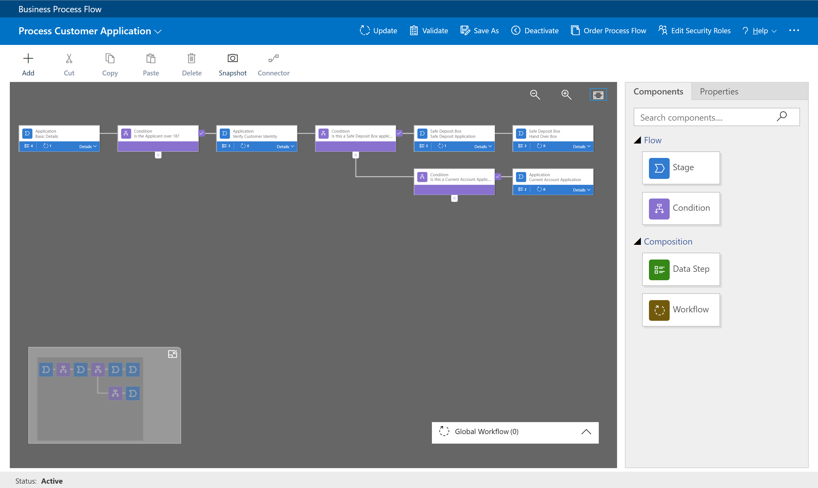
Business Process Flow
Visual indicators that tell users where they are in the business process
Reduce the need for training
Configurable to support common line of business methodologies

Slide 26
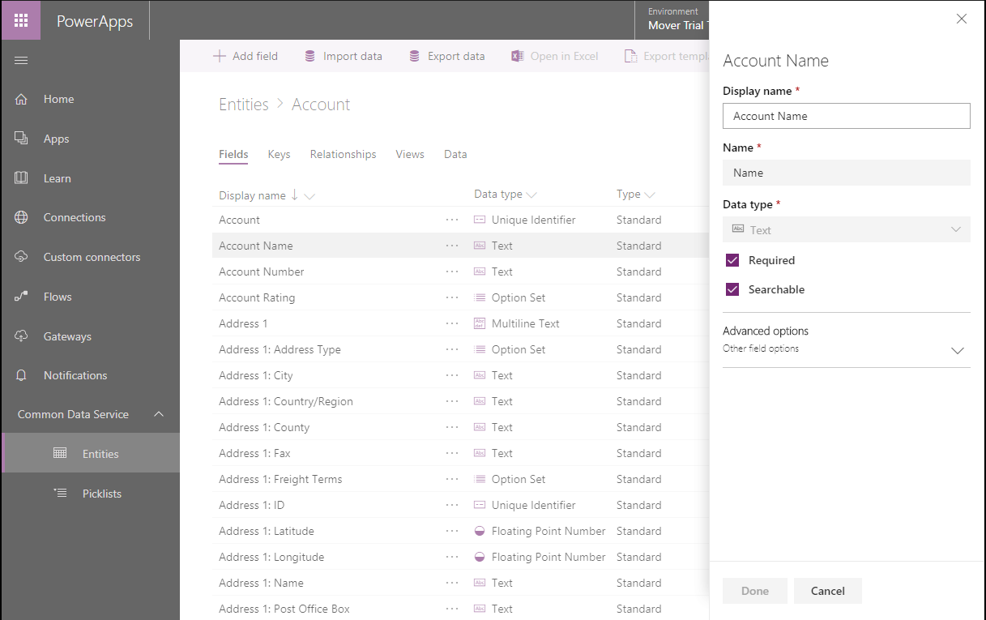
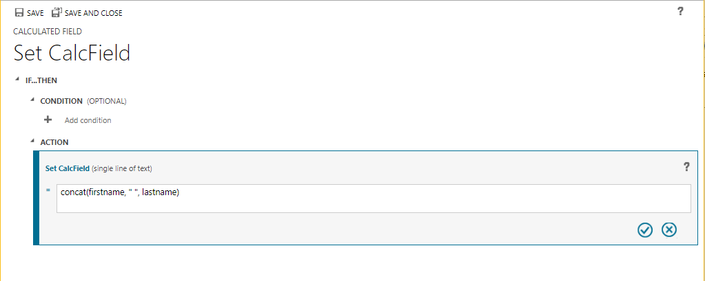
Server Side Logic
Server-side logic bound to entities, works across all apps
Create calculated and roll up fields
Easily create validation and set field defaults
Update related entities with synchronous workflows

Slide 27
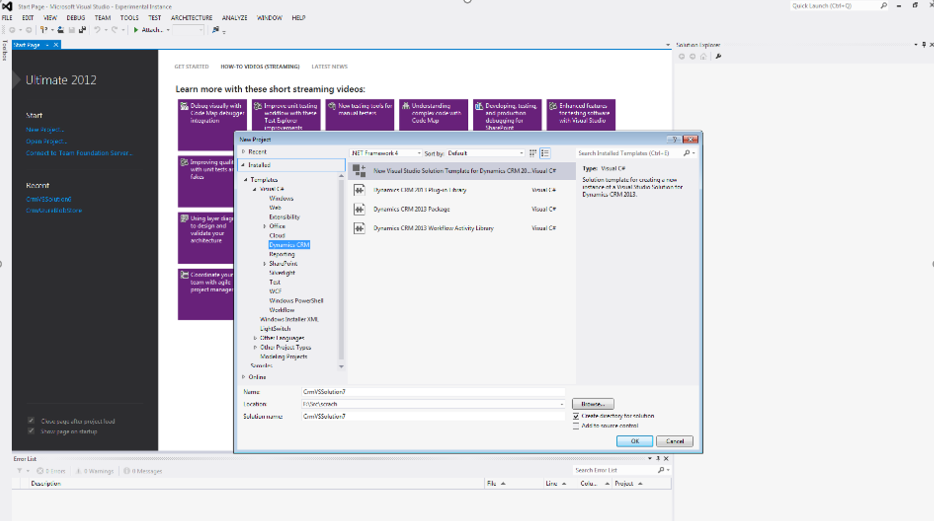
Developer Capabilities
Robust solution framework for application install and updates
Visual Studio integrated developer toolkit
Odata web API
.Net SDK
Sandbox instances for ALM operations

Slide 28
Canvas apps and Model-driven apps are complementary to each other
Canvas Apps | Model Driven Apps
Start with the User Experience or Data | Start with the Data Model (schema)
Build visually appealing, pixel-perfect apps | Component-driven approach to app building
Use concepts like screens, controls, formulae, connections | Use components like site maps, entities, forms, views, charts, dashboards, business process flows
Separate mobile and tablet app creation experiences | Responsive web & mobile apps out of the box
Create mash-up apps using data from multiple data sources using the 200+ connectors or custom connectors | Create apps using entities and virtual-entities in CDS for Apps
Use any PowerApps license (Office 365/P1-P2 or Dynamics 365) | Only PowerApps Plan 2 or Dynamics 365 Enterprise license
Great for building task-focused apps for a specific personas | Great for back-office scenarios involving complex business processes
Security and access for the data is managed on the data-source chosen | Add role-based security and row-level security to your data
Use entities stored in CDS for Apps through CDS connector (P1/P2 required) | Use Business Process Flows, code add-ins & real-time workflows

Slide 29
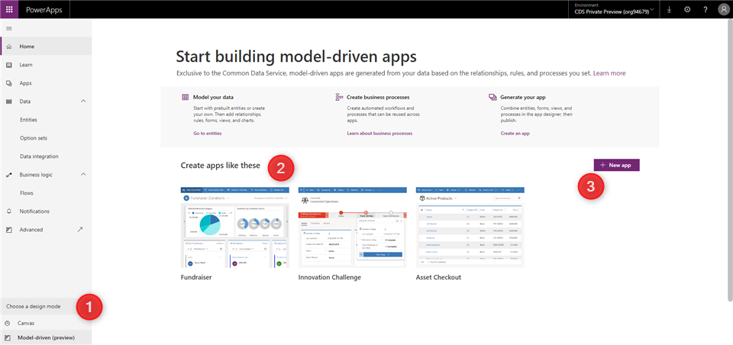
PowerApps Maker Portal [https://web.powerapps.com/]
Switch design mode to Model-driven
Explore sample apps
Create new Model-driven apps

Slide 30
Model-driven app components - Data
Component | Description | Designer
Entity | An item with properties that you track, such as a contact or account. Many standard entities are available. You can customize a non-system standard entity (production entity) or create a custom entity from scratch. | PowerApps entity designer
Field | A property that is associated with an entity. A field is defined by a data type, which determines the type of data that can be entered or selected. Examples include text, number, date and time, currency, or lookup (creates a relationship with another entity). Fields typically are used with forms, views, and searches. | PowerApps entity designer
Relationship | Entity relationships define how entities can be related to each other. There are 1:N (one-to-many), N:1 (many-to-one), and N:N (many-to-many) types of relationships . For example, adding a lookup field to an entity creates a new 1:N relationship between the two entities and lets you put that lookup field on a form. | PowerApps entity designer
Option set field | This is a special type of field, which provides the user a set of predetermined options. Each option has a number value and label. When added to a form, this field displays a control for the user to select an option. There are two kinds of option sets; option sets, where the user can only select one option, and multi-select options sets, which allow more than one selection. | PowerApps option set designer

Slide 31
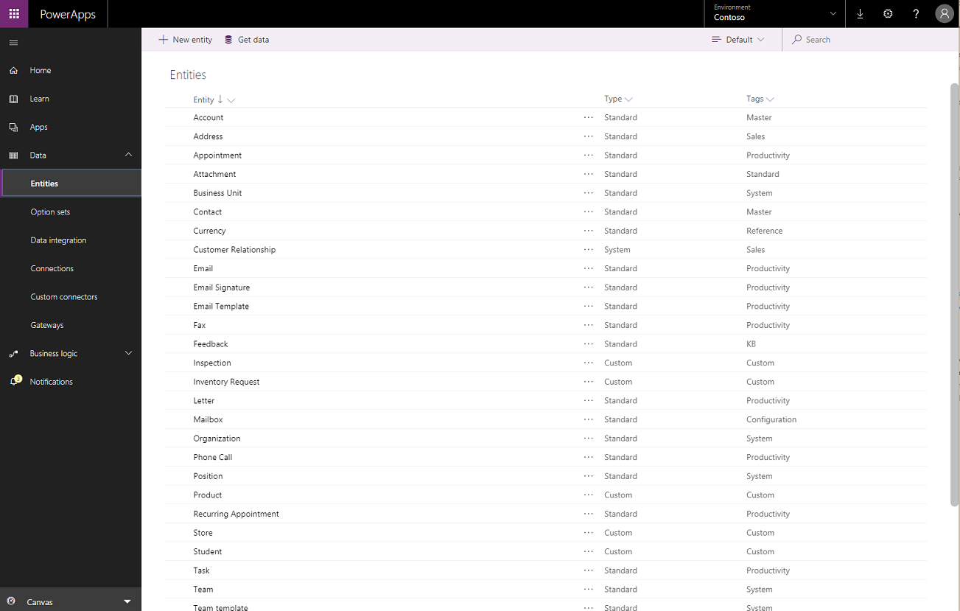
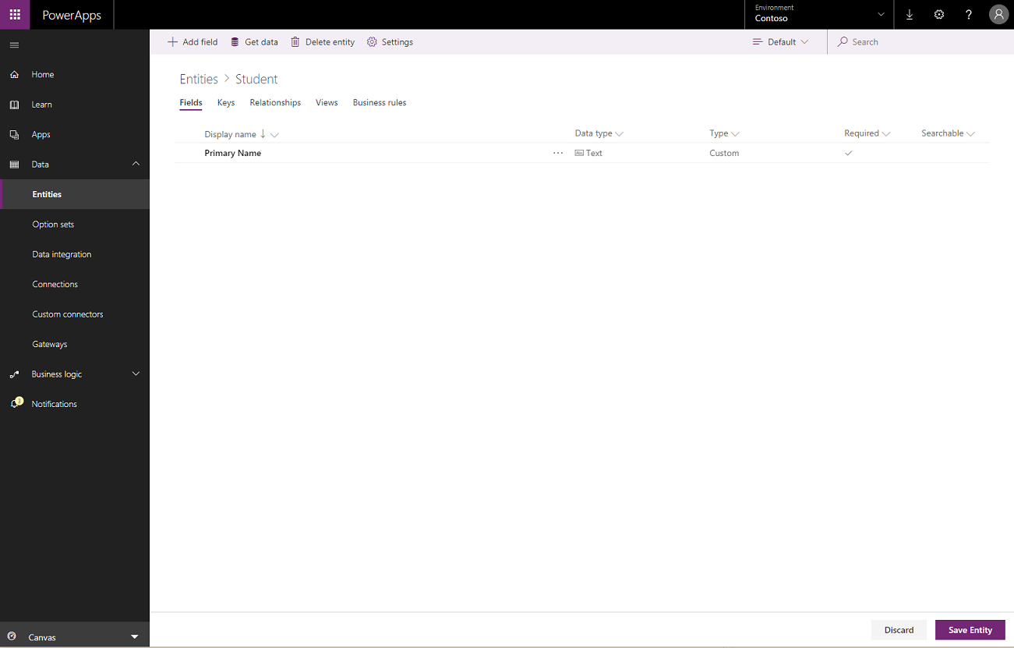
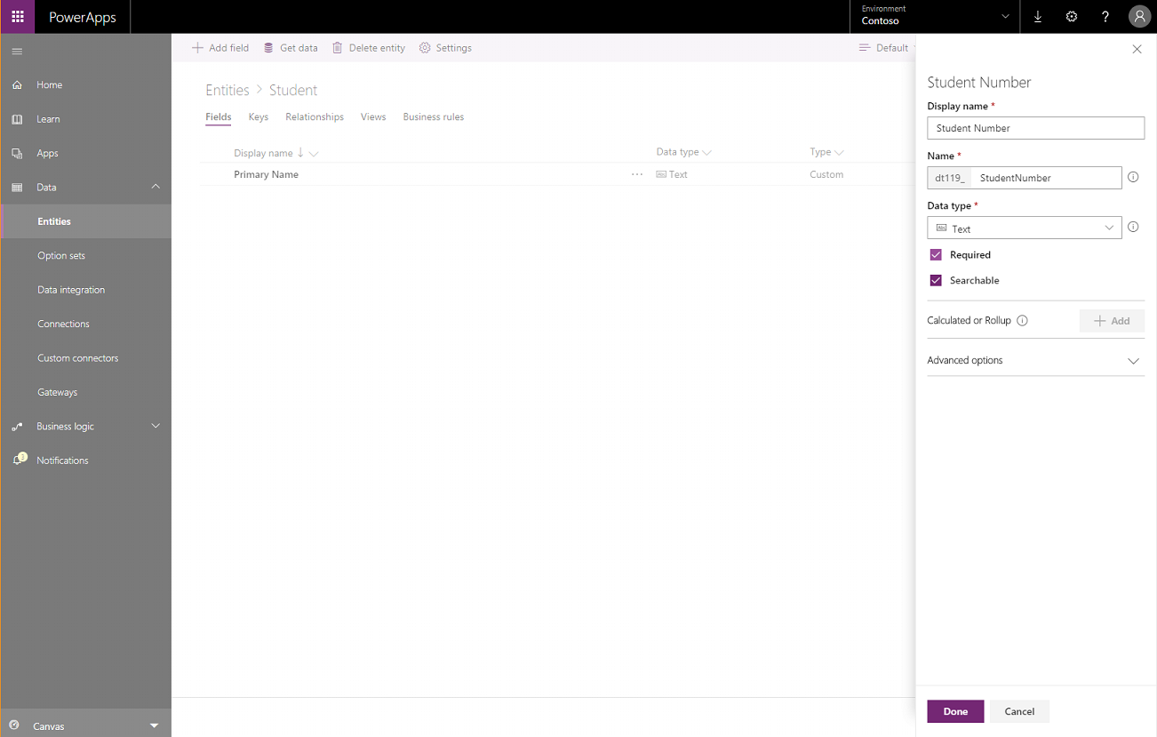

Slide 32
Model-driven app components - UI
Component | Description | Designer
App | Determines the application fundamentals such as components, properties, client type, and URL for your app. | App designer
Site map | Specifies the navigation for your app. | Site map designer
Form | A set of data-entry fields for a given entity that matches the items that your organization tracks for the entity. For example, a set of data-entry fields that where user’s input relevant information to track a customer’s previous orders along with specific requested reorder dates. | Form designer
View | Views define how a list of records for a specific entity is displayed in your application. A view defines the columns to display, width of each column, sort behavior, and the default filters. | View designer

Slide 33
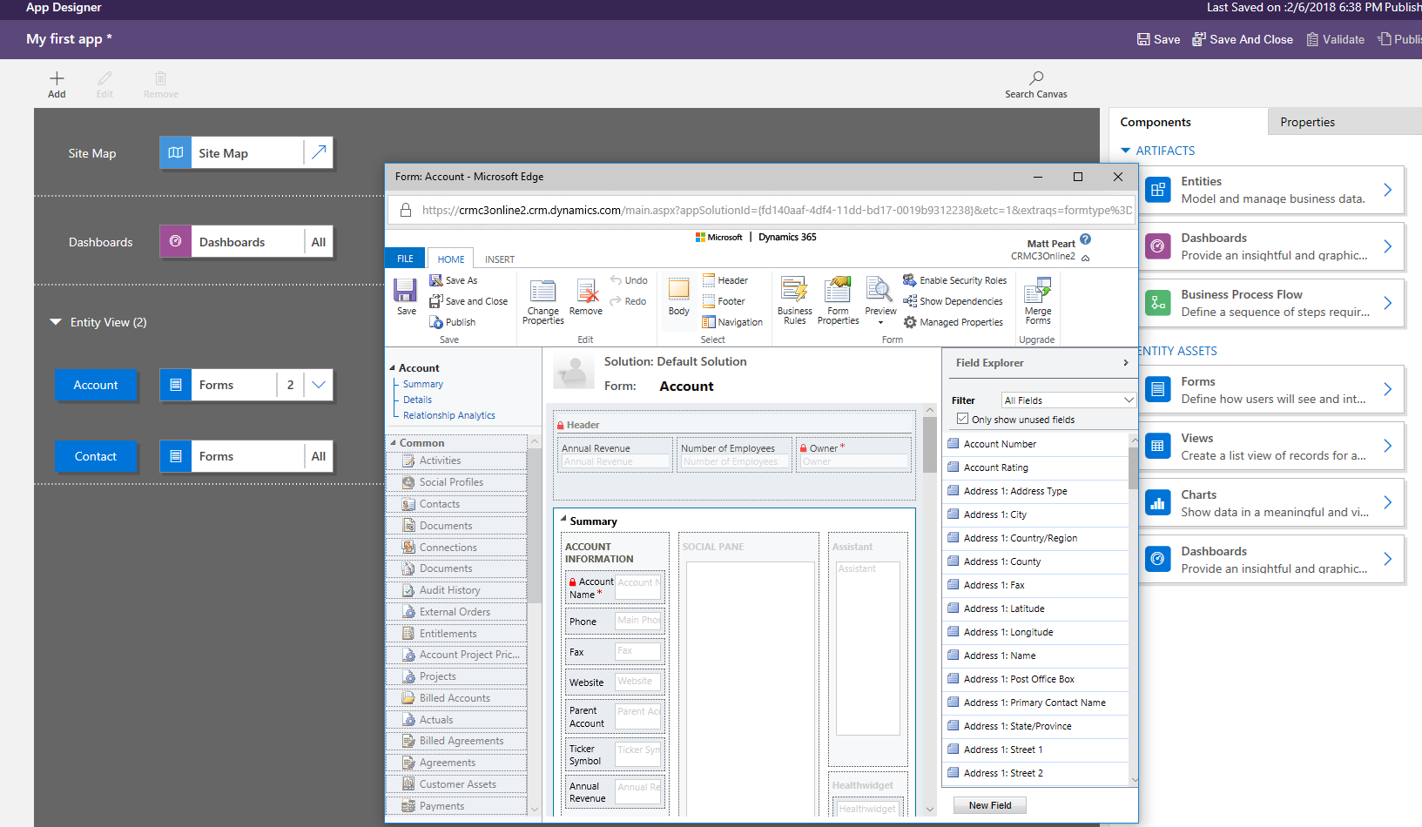

Slide 34
Model-driven app components - Logic
Type of logic | Description | Designer
Business process flow | An online process that walks users through a standard business process. For example, use a business process flow if you want everyone to handle customer service requests the same way, or to require staff to gain approval for an invoice before submitting an order. | Business process flow designer
Workflow | Workflows automate business processes without a user interface. Designers use workflows to initiate automation that doesn’t require any user interaction. | Workflow designer
Actions | Actions are a type of process that let you manually invoke actions, including custom actions, directly from a workflow. | Process designer
Business rule | Used to apply rule or recommendation logic to a form, such as to set field requirements, hide fields, or validate data. App designers use a simple interface to implement and maintain fast-changing and commonly used rules. | Business rule designer
Flow | Flow is a cloud-based service that lets you create automated workflows between apps and services to get notifications, synchronize files, collect data, and more. | Microsoft Flow

Slide 35
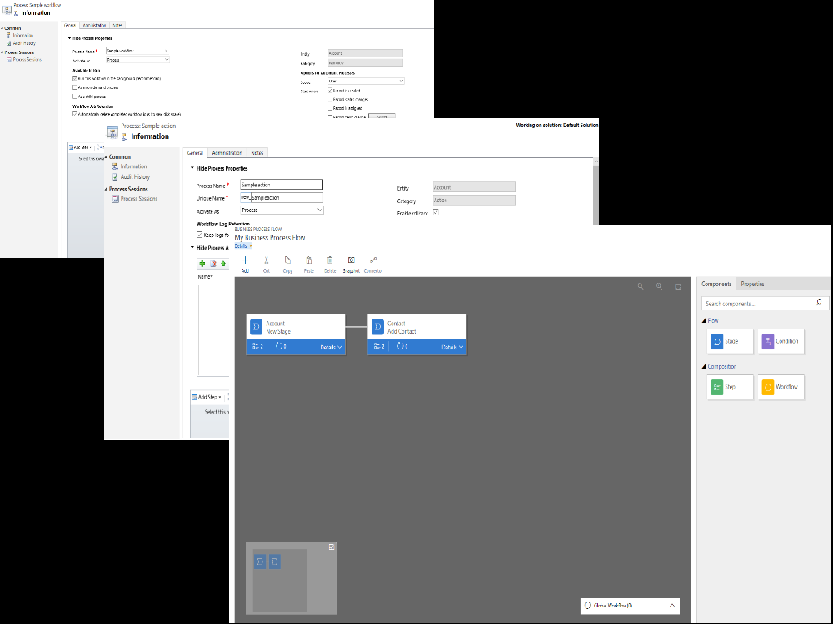

Slide 36
Model-driven app components - Visualizations
Component | Description | Designer
Chart | A single graphic visualization that can be displayed within a view, on a form, or be added to a dashboard. | Chart designer
Dashboard | Functions as a palate for one or more graphic visualizations that provide an overview of actionable business data. | Dashboard designer
Embedded Power BI | Add embedded Power BI tiles and dashboards to your app. Power BI is a cloud-based service that provides business intelligence insight. | Combination of chart designer, dashboard designer, and Power BI

Slide 37
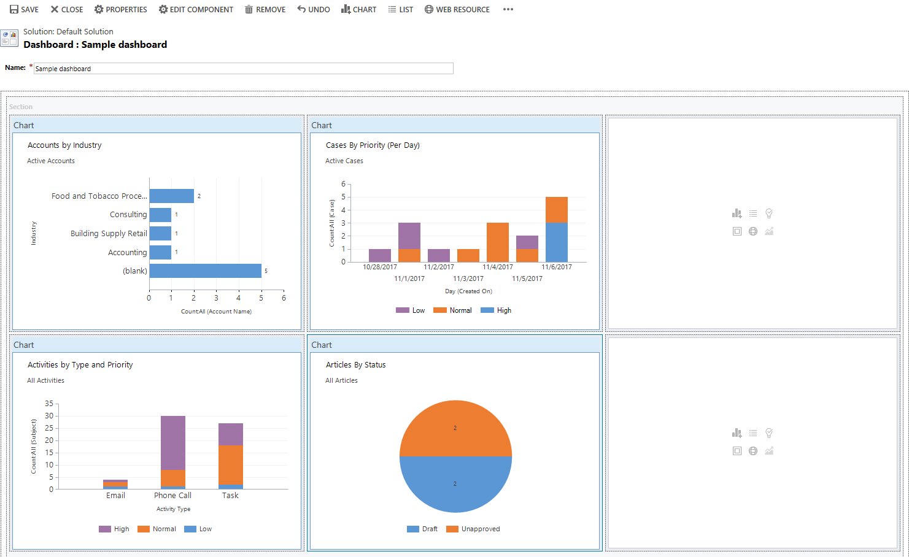

Slide 38
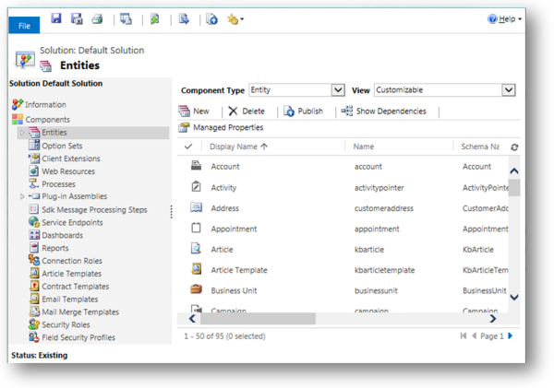
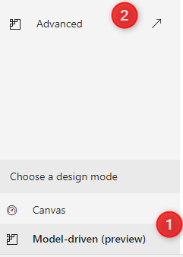
Advanced Model-driven app making
To open solution explorer, select Model-driven on the left pane of PowerApps
Then select the Advanced tab.

Slide 39
Model-driven sample apps
In order to play or edit model-driven sample apps, the apps must first be provisioned in a Common Data Service database. First create a trial environment and database and be sure to check Include sample apps and data.

Slide 40
Demo
Notes:
IMPORTANT:
→ Having everyone start off the lab with a new CDS for Apps environment (created after Apr 1, 2018) and a database provisioned is important. Will help avoid issues further down in the lab. On slide 42 → walk the attendees through creating an environment and the database as an instructor led section where the instructor walk through the steps and asks everyone to follow along.
→ After you introduce the lab, do a live demo of the entire lab solution – all four modules. This will help set context and orient attendees to the overall solution that they’re going to build during the day.

