Slide 3
Introduction to PowerApps Components
Sreeni Amrutur
Dee Blaney

Slide 4
Audience
Role
Level
Knowledge
Power User/Citizen Developer
Introduction
Basic knowledge of building canvas apps

Slide 5
Agenda
Components Overview
Demo
Q & A

Slide 6
Components Definition
Components are reusable building blocks for canvas apps so that app makers can create custom controls to use in an app or across apps.
You can define a set of controls to reuse inside an app.
You could import a component into other apps as well.
They behave in a master-instance manner, meaning that any updates you make to the original (‘master-instance’) will apply to other copies in the same app.
Reusable
Share
Export
Import

Slide 7
Why Components?
Components are useful in building larger apps that have similar control patterns. If you update a component definition, all instances in the app reflect your changes. You can also improve performance by using one or more components because you don't copy and paste controls, which duplicates overhead. Components also facilitates collaborative development and standardizes look-and-feel in an organization.
Example: You create a useful group of controls like a header. Then you copy and paste it on each screen of your app where it’s needed. But if you wanted to update any part of your controls, such as an icon, a formula, or even one color, you would need to make that same change to every copy.
That’s a lot of small edits that can add up to a significant task.
So, the experimental Components feature makes this experience easier.

Slide 8
Getting Started

Slide 9
Enable the Components Feature
The components feature is still experimental and disabled by default. This means things can change and it may affect apps with this feature!
To enable the components feature:
Open the App Settings screen
Select Advanced settings
Enable the feature, as well as ensuring that Improved app rendering is also enabled

Slide 10
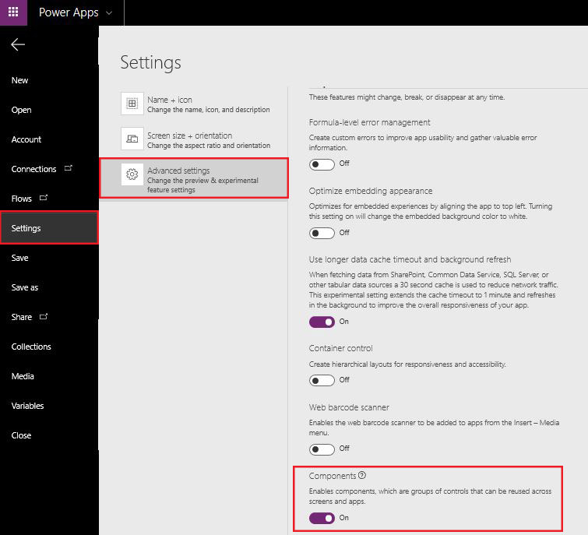
Prerequisites Screenshot

Slide 11
Prerequisites
Once the components setting is turned on, new options can be seen on the page (a components option next to screens and components drop down options in the Insert menu). The option to create a new component can be found in both of these menus.

Slide 12
Component Examples
Create a menu which you can use in multiple screens
Create your own gallery layouts and reuse them within your app
Create your own custom controls Create entire screens which you can reuse within your app
In short, you are able to create your own component library which you can use over and over...

Slide 13
Demo Create an example component

Slide 14
In this demo, we will create a menu component that resembles the graphic on the right. You can change the text and use this menu component in multiple screens, apps, or both. https://docs.microsoft.com/en-us/powerapps/maker/canvas-apps/create-component

Slide 15
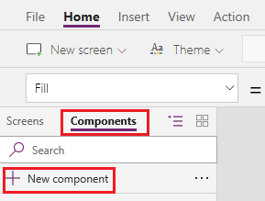
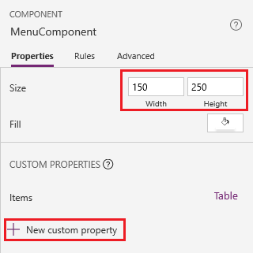
Create Component
In Power Apps Studio, create a blank app.
In the left navigation bar, open the list of components, and then select New component.
While hovering over the new component, select the ellipsis (...), select Rename, and then type or paste MenuComponent.
In the right-hand pane, set the component's width to 150 and its height to 250, and then select New custom property.

Slide 16
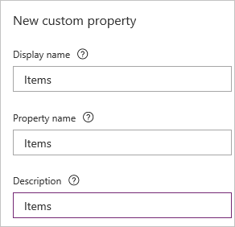
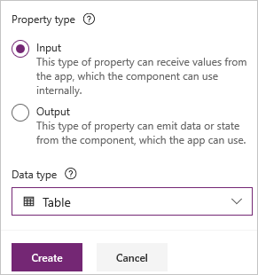
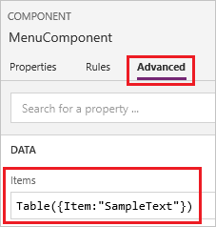
Create Component
In the Display name, Property name, and Description boxes, type or paste Items.
In the Data type list, select Table, and then select Create.
Set the component's Items property to this formula: Table({Item:"SampleText"})
When you specify a property name, don't include spaces because you'll refer to the component by this name when you write a formula (for example, ComponentName.PropertyName).
The display name appears on the Properties tab of the right-hand pane if you select the component. A descriptive display name helps you and other makers understand the purpose of this property. The Description appears in a tooltip if you hover over the display name of this property in the Properties tab.
The Items property is set to a default value based on the data type that you specified, but you can set it to a value that suits your needs. If you specified a data type of Table or Record, you may want to change the value of the Items property to match the data schema that you want to input to the component. In this case, you'll change it to a list of strings.
You can set the property's value in the formula bar if you select the name of the property on the Properties tab of the right-hand pane.

Slide 17
Create Component
In the component, insert a blank vertical Gallery control.
Make sure that the property list shows the Items property (as it does by default), and then set the value of that property to this expression: MenuComponent.Items
This way, the Items property of the Gallery control reads and depends on the Items input property of the component.
Set the Gallery control's BorderThickness property to 1 and its TemplateSize property to 50.
In the template of the Gallery control, add a Label control.
Next, you'll add the component to a screen and specify a table of strings for the component to show.
In the left navigation bar, select the list of screens, and then select the default screen.

Slide 18
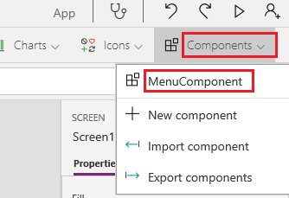
Create Component
Add the component to a screen
On the Insert tab, open the Components menu, and then select MenuComponent.
The new component is named MenuComponent_1 by default.
Set the Items property of MenuComponent_1 to this formula: Table({Item:"Home"}, {Item:"Admin"}, {Item:"About"}, {Item:"Help"})
Next, you'll create an output property that reflects the item that the user selects in the menu.

Slide 19
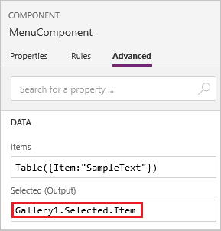
Create Component
Add the component to a screen
Open the list of components, and then select MenuComponent.
In the right-hand pane, select the Properties tab, and then select New custom property.
In the Display name, Property name, and Description boxes, type or paste Selected.
Under Property type, select Output, and then select Create.
On the Advanced tab, set the value of the Selected property to this expression, adjusting the numeral in the gallery name if necessary: Gallery1.Selected.Item

Slide 20
On the default screen of the app, add a label, and set its Text property to this expression, adjusting the numeral in the component name if necessary: MenuComponent_1.Selected
Note that MenuComponent_1 is the default name of an instance, not the name of the component definition. You can rename any instance.
While holding down the Alt key, select each item in the menu.
The Label control reflects the menu item that you selected most recently.
Create Component
Add the component to a screen
Congrats, you’ve built your first component

Slide 21
Component Specifics
Think of a component as an encapsulated black box with properties as the interface. You can't access controls in the component from outside of the component, and you can't refer to anything outside of the component from inside the component. If you try, an error appears. Scope restrictions keep the data contract of a component simple and cohesive, and it helps enable seamless component-definition updates, especially across apps. You can update the data contract of the component by creating one or more custom properties.
Components don't support the UpdateContext function, but you can create and update variables in a component by using the Set function. The scope of these variables is limited to the component, but you can access them from outside the component by leveraging custom output properties.
If you export a component, you create a local file that you can import to a different app.
A component can receive input values and emit data if you create one or more custom properties. These scenarios are advanced and require you to understand formulas and binding contracts.
An input property is how a component receives data to be used in the component. Input properties appear in the Properties tab of the right-hand pane if an instance of the component is selected. You can configure input properties with expressions or formulas, just as you configure standard properties in other controls.
Output properties can emit data or component state. For example, the Selected property on a Gallery control is an output property. When you create an output property, you can determine what other controls can refer to the component state.

Slide 22
Known limitations
As of this writing, data sources aren't saved with components, so forms and data tables are disabled.
Power Apps doesn't support collections in components.
Nesting a component inside gallery, form or a datacard isn’t supported.
A master instance of a component is a local master and scoped to the app. If you change a master instance, only copies of the component within the app will reflect the change. Copies in other apps will remain the same unless you import the component library again. All master instances in those apps will be automatically detected and updated.
You can't package media files when you import a component.
No OnStart, OnVisible or OnHidden action which means no simple way of setting default values in centralized way

Slide 23
Resources
Feature Documentation
Video: Introduction
Video: Header Component
Introducing Components blog by Yifei Wang
Full Documentation
Component Best Practices Playlist (Bookmark this!)
10 sample components
Canvas Apps Components Samples Gallery

Slide 24
Q & A

