Slide 1
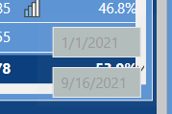
Column titles all in one visual. Features, LY Month, MTD. MTD LY, YTD, MTD + EOM, and YTD thru EOM and entire year. All related to these slicers.
Hidden slicer tied to main slicer for certain measures

